Slide 1


Grading
Application
MCON 152
Semester Project
By:
Malka Sokol, Tehila Raful & Zohar Tal

Slide 2
OVERVIEW
Our Grading application makes it easier for teachers to insert and keep track of students grades throughout the semester.

Slide 3
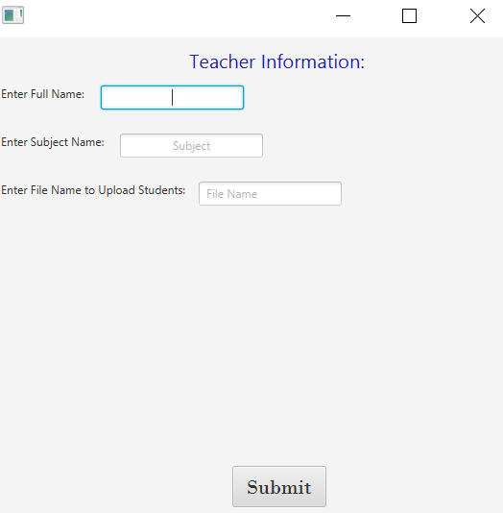



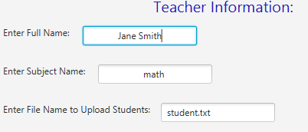
Login Window
For a new user:
Enter in your name, the subject you teach and the file containing the student roster.

Slide 4
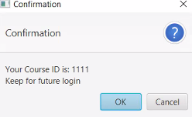

Confirmation
A prompt with the course ID will pop up.
Keep this ID for future use to login.

Slide 5
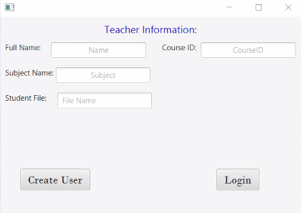
Returning User
If you are a returning user, put in your
course ID and the system will load in your previous data.

Slide 6

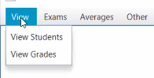
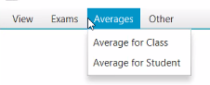
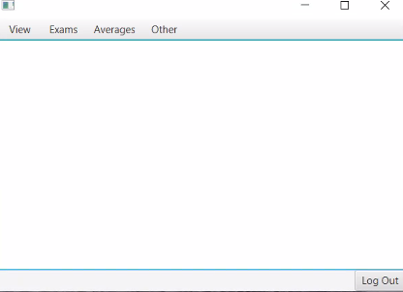

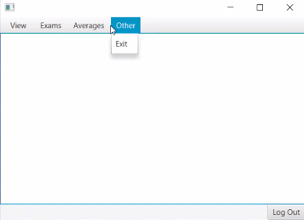
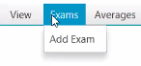




Menu Bar Items
Averages:
Class Average
Student Average
View :
Students
Grades
Exams:
Add Exam
Other:
Exit
Logout Button:
Use this button to logout at any time
Back Button:
Use this button to go to the previous screen at any time

Slide 7
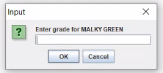
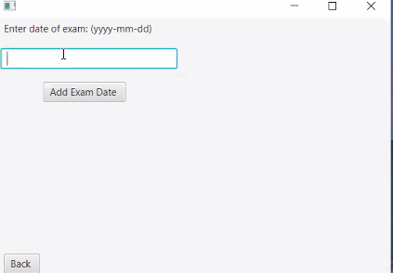

Add an Exam
To add an exam start by entering the date of the exam in the format specified.
Then enter in grades of the student shown in the dialogue box.

Slide 8
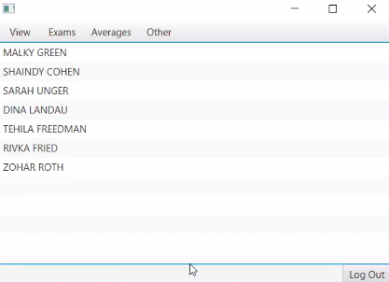
View Students
View students provides a list of the students loaded in from the roster file

Slide 9
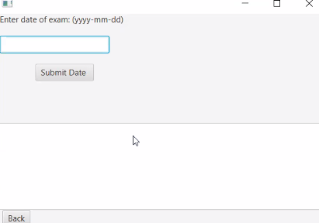
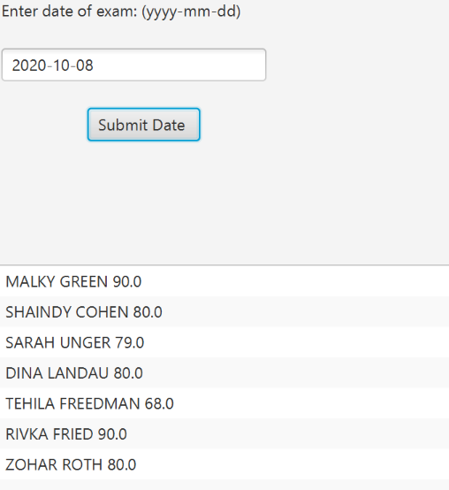
View Grades
Start by entering the date of the exam.
After you click submit the results will be shown on the bottom of the screen.

Slide 10
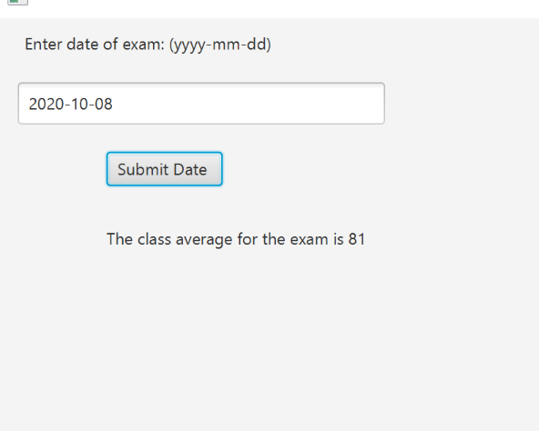


Class Average for an Exam
To see the class average for a specific exam, enter in the exam date in the specified format and the results will appear below.

Slide 11
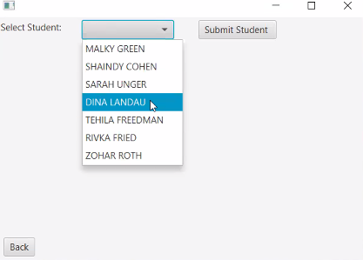

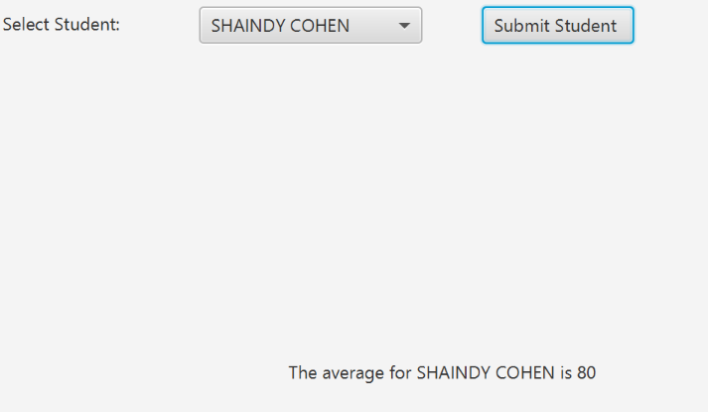
Averages for a Student
Select the student’s name from the dropdown list to see their calculated average.

Slide 12
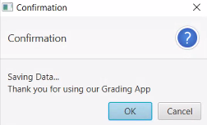
Exit Window
This window confirms you exited the program safely

